Slide 1
Testing with Locust - Load Testing Tool Using python - Installation, Execution, Design and Reporting A sample project Rob Allan

Slide 2
Summary
Locust and Python Installation
System Under Test - Flask web server
System Under Test - Flask API server
Overview of Basic Web Load Tester
Overview of Basic API Load Tester
Running Locust from web GUI
Running Locust from Command Line
Code Location for all the project - at Rob’s github
Why - Supports Code based load testing using Python, lends itself to CICD integration and supports web and API based testing – as well as plugins for other protocols such as RPC and gRPC
Further info on Locust is available here … https://docs.locust.io/en/stable/

Slide 3
Locust and Python Installation
Insta;l Python – python –v to verify - tested against 3.9.6
This should include pip by default
Install locust - pip install locust – you may choose to sue an env to limit scope of packages
That’s it for install - easy…

Slide 4
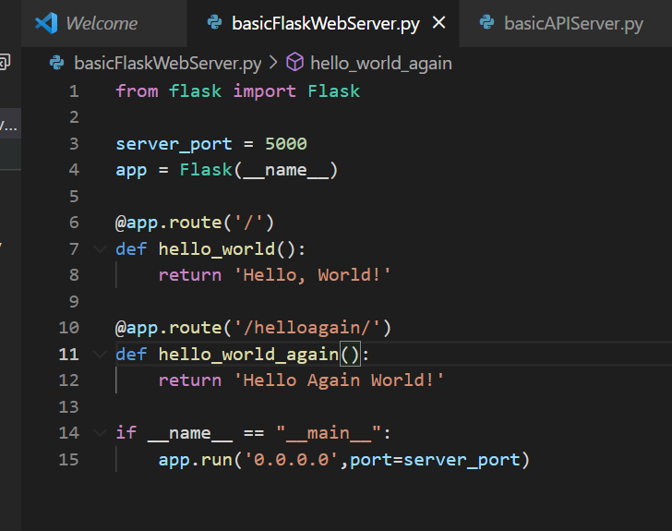
System Under Test - Flask web server
For this testing a simple Flask web server is set up - to respond to specific URLs on a known port and limited set of routes – to run python .\basicFlaskWebServer.py
All code in github at end of this document.

Slide 5
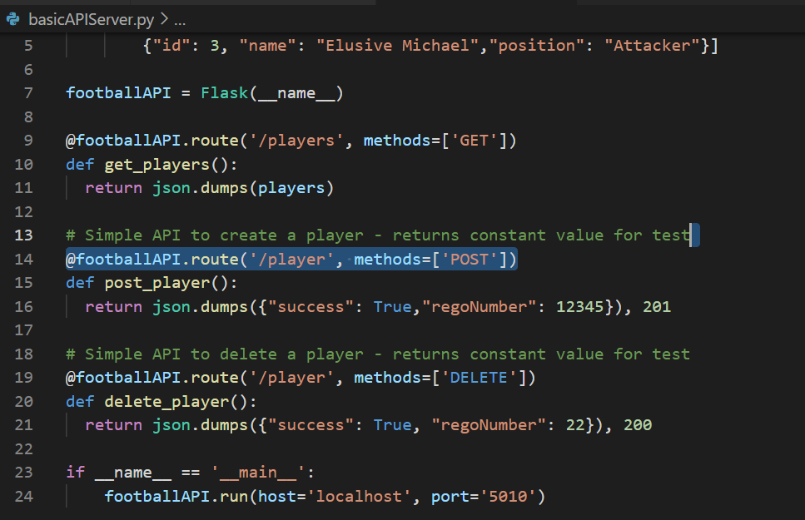
System Under Test - Flask API server
For this testing a simple Flask API server is set up - to respond to specific URLs on a known port and limited set of routes – also define JSON message bodies and response codes - to run python .\basicAPIServer.py
All code in github at end of this document.

Slide 6
Overview of Basic Web Load Tester
A simple file locustfile_web.py is provided.
Shows a simple file with several classes and with weighted task (more weighting more executions).
Shows the life cycle of tests with events before and after the complete cycle, or alternatively before and after each task
Calls to specific URLs, with validations for total time and text validations
Wait time can be used to control execution

Slide 7
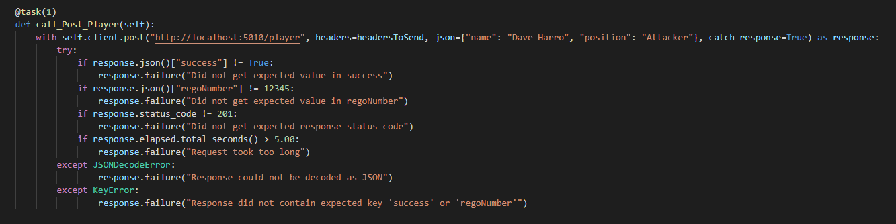
Overview of Basic API Load Tester
A simple file locustfile_api.py is provided.
Shows a simple file with single classes and with equally weighted tasks (more weighting more executions).
Once again shows the life cycle of tests with events before and after the complete cycle, or alternatively before and after each task
Calls to specific URLs, with validations for total time, response code JSON text validations
Extract is shown below

Slide 8
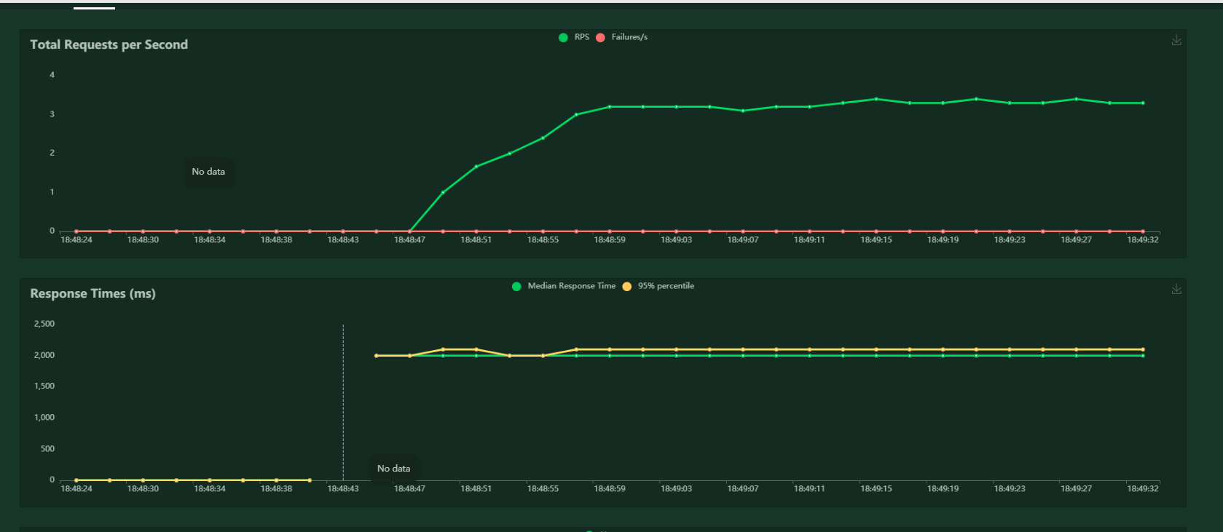
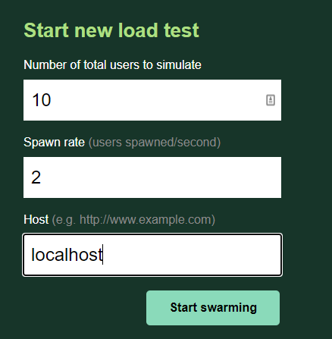
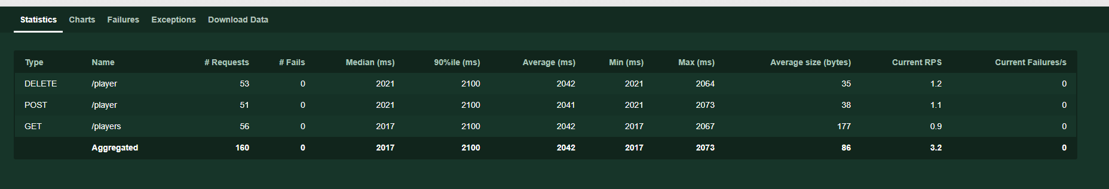
Running Locust from web GUI
The test cycles can be invoked to provoke a web GUI – typically on port 8089 - users can then control the number of threads and ramp up rate. Additionally the outputs can be examined- to invoke locust filename - here
locust -f locustfile_api.py
locust -f locustfile_web.py

Slide 9
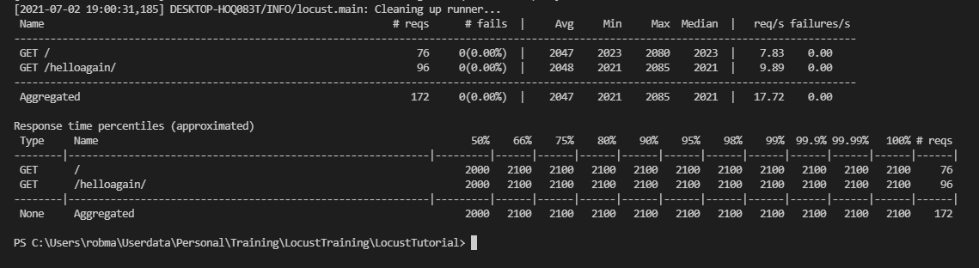
Running Locust from Command Line
This will allows the execution with arguments. Headless typically for web cases. This example creates extra output example csv values, runs for 10 seconds, with up to 100 user with a ramp up rate of 10 per second.
locust -f locustfile_web.py --csv=example --headless --host wfng -u 100 -r 10 -t 10s
Further options through locust help

Slide 10
Code Location for all the project - at Rob’s github

